Slide 1
How to add an item process type to an item using the Work Order functionality
Yoel Kortick
Senior Librarian

Slide 2

Agenda
Introduction
The work order types and the process type
Applying the process type to an item

Slide 3
Introduction

Slide 4
Introduction
This presentation will not investigate the full use of the Work Order functionality, but rather will focus specifically how to add an item process type to an item using the Work Order functionality
For a full explanation of the full use of the Work Order functionality see How to define and manage work orders in Alma.pptx
The full use of the Work Order functionality includes transiting the item to the Work Order department and using statuses in the Work Order department.
The method we are showing here does not include transiting the item to the Work Order department and does not include using statuses in the Work Order department.

Slide 5
Introduction
This presentation will focus on the relationship between the work order type, work order department and physical item process type.
Specifically, we will investigate how process types can be added to the item using definitions from the Work Order type functionality.

Slide 6
The work order types and the process type

Slide 7
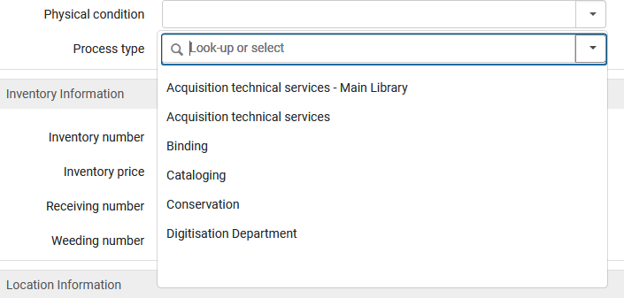
The work order types and the process type
These are the current process types which are currently available in a specific institution of Alma as seen in the physical item editor:

Slide 8
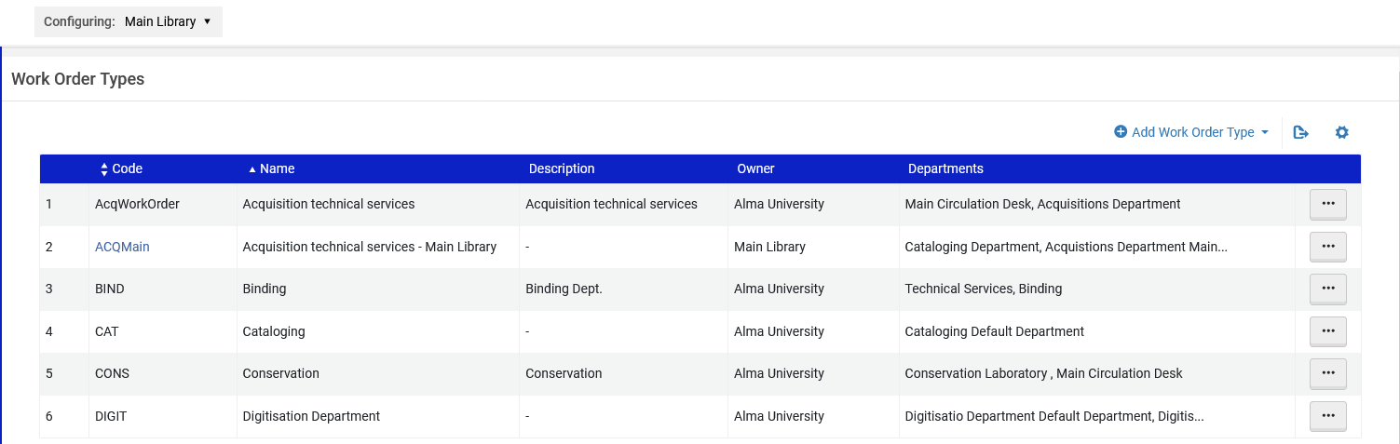
The work order types and the process type
The list of process types in the physical item editor is the same as the list of process types when doing "Configuration > Choose relevant "Configuring" library on top > General > Work Orders and Departments > Work Order Types

Slide 9
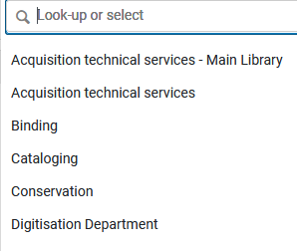
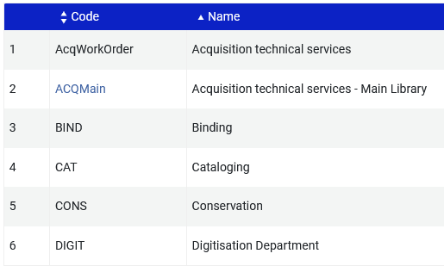
The work order types and the process type
Physical Item Editor
Configuration > General > Work Order Types

Slide 10
The work order types and the process type
For details of how to add a new process type see How to define and manage work orders in Alma.pptx

Slide 11
Applying the process type to an item

Slide 12
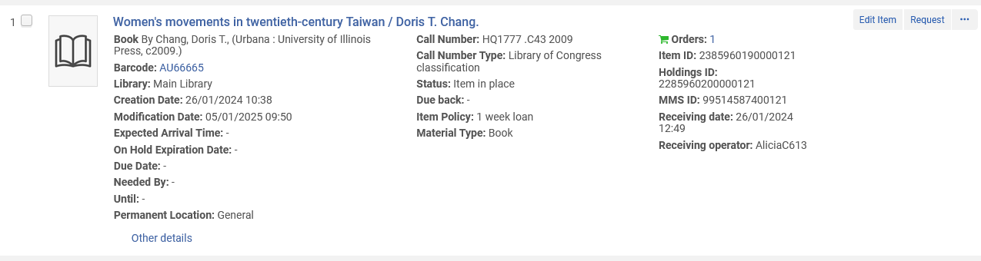
Applying the process type to an item
Here is item barcode AU66665, "Women's movements in twentieth-century Taiwan".
It does not have a process type.
No process type appears here

Slide 13
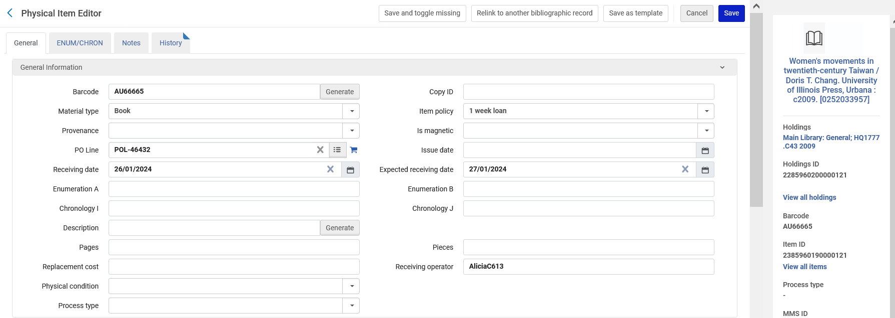
Applying the process type to an item
Here is item barcode AU66665, "Women's movements in twentieth-century Taiwan".
It does not have a process type.
No process type appears here

Slide 14
Applying the process type to an item
We want to give this item process type "Conservation".
As explained in the introduction we are not going to take advantage of the full use of the Work Order functionality as described at How to define and manage work orders in Alma.pptx .
Instead, we will focus specifically on adding an item process type to an item using the Work Order functionality

Slide 15
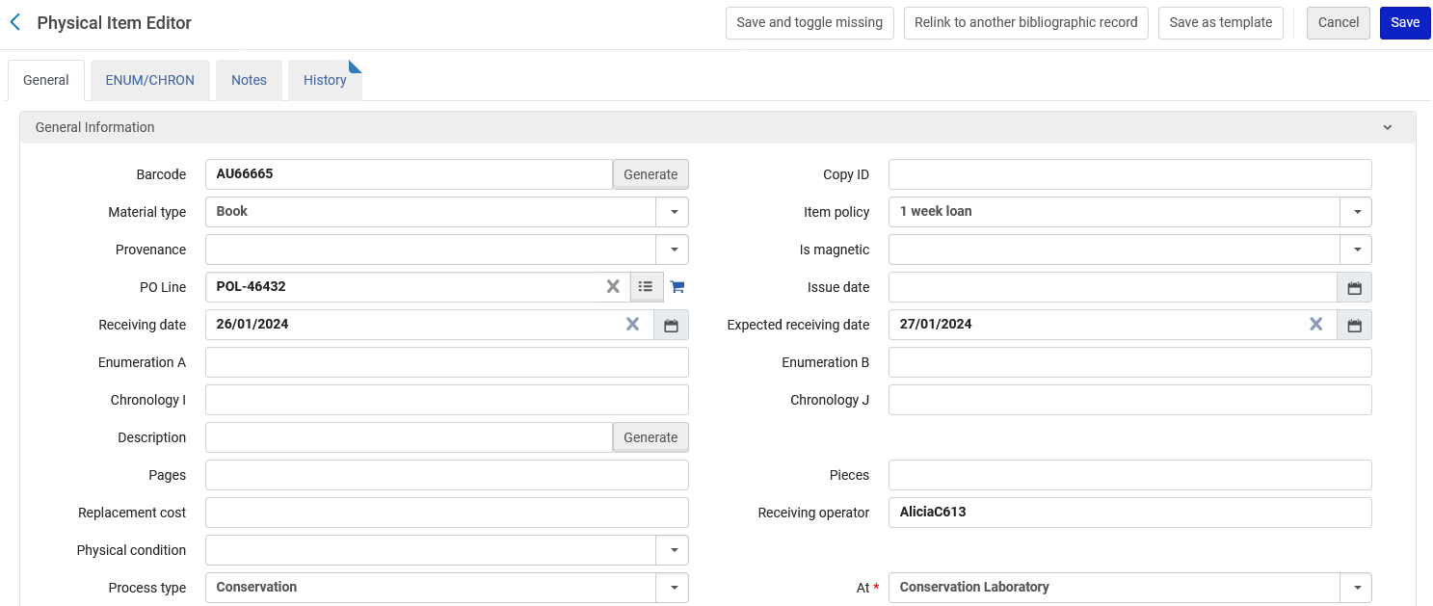
Applying the process type to an item
From within the Physical Item editor, in the field "process type" we will choose the process type (Work Order Type) "Conservation" and then save the item.
When we filled in the Process Type the "At" field appeared also got filled in

Slide 16
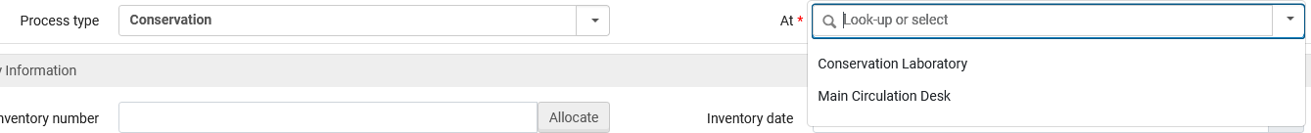
Applying the process type to an item
As pointed out: when we filled in the process type the "At" also appeared and got filled in.
The "At" can be one of the departments of the process type (Work Order Type)
  In this specific case the departments for process type (Work Order Type) "Conservation" are "Conservation Laboratory" and "Main Circulation Desk"
The department

Slide 17
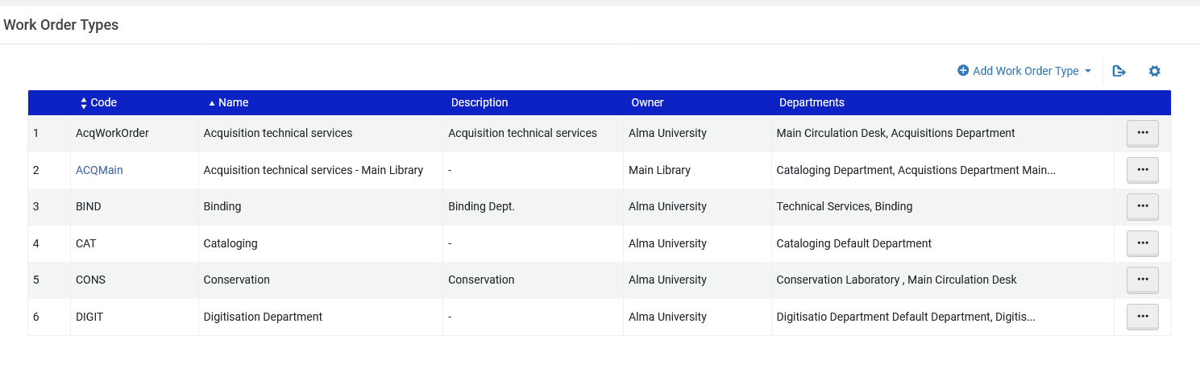
Applying the process type to an item
In this specific case the departments for process type (Work Order Type) "Conservation" are "Conservation Laboratory" and "Main Circulation Desk"

Slide 18
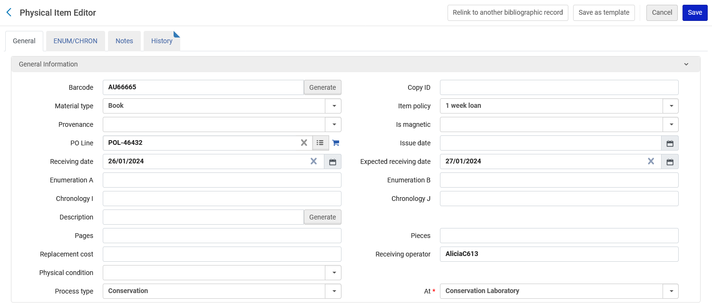
Applying the process type to an item
The process type (Work Order Type) has been applied and the item is at the "Conservation Laboratory"

Slide 19
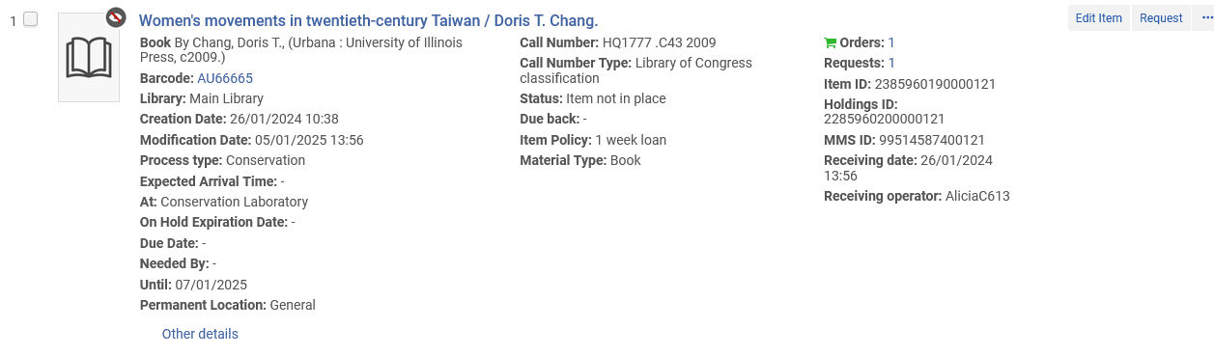
Applying the process type to an item
The process type is seen in the repository search results
Note that the physical item became suppressed when a process type was applied, and therefore it will not appear in discovery
Note that the physical item became "not in place" when a process type was applied.

Slide 20
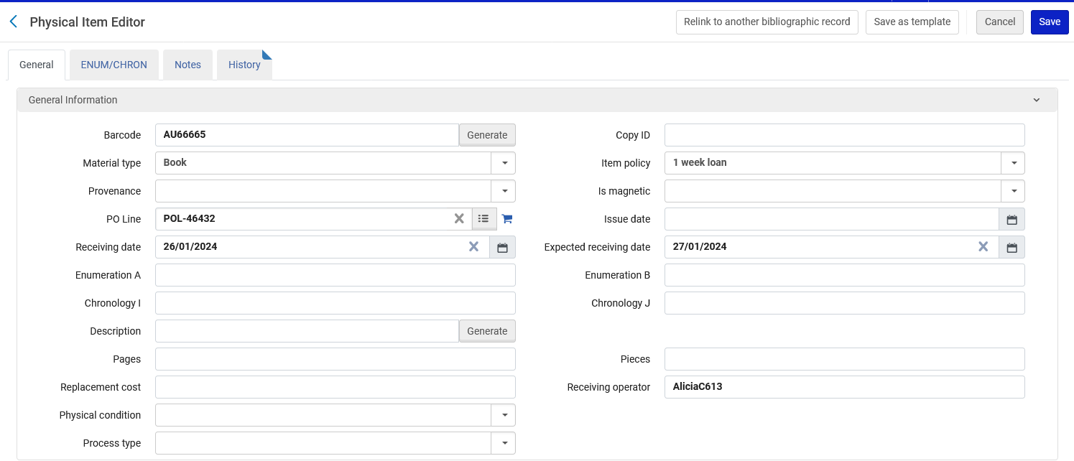
Applying the process type to an item
When the item is no longer in the process type "Conservation" (and is no longer at the Conservation laboratory) we can remove the process type from the item and save.

Slide 21
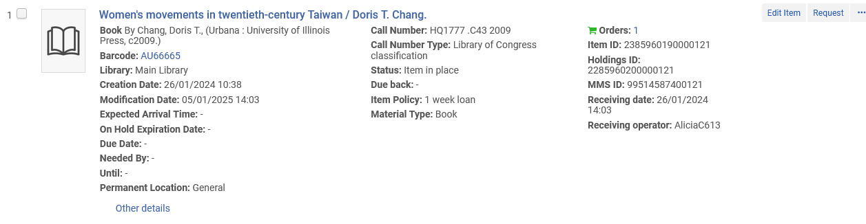
Applying the process type to an item
When the item is no longer in the process type "Conservation" (and is no longer at the Conservation laboratory) we can remove the process type from the item and save.
The process is complete.
No process type appears here
Note that now the physical item is "in place"
Note that the physical item is no longer suppressed

